Slide 1


Slide 2


Our Purpose: To deliver superior health plan solutions that decrease plan costs and enhance overall benefits
About Us
Established 15 years ago by employee benefit brokers with over 50 years of experience in the business.
We offer traditional health insurance plans : (Select Health, Regence BCBS, United Healthcare , and more)
We also offer non-traditional health plans that we have developed, 5 plans.
These 5 plans combine national virtual primary care or regional urgent care and primary care with self funded or medical cost sharing plans.
The purpose of these plans is to make plans more affordable to both employers and employees
Lower plan monthly costs by 30%-50%
Provide more comprehensive coverage.
Lower out-of-pocket plan costs close to ZERO where possible.

Slide 3

4 MINUTE EMPLOYER VIDEO

Slide 4

Providers Will Bill Up to 900% of Medicare
Providers will accept around 250% of Medicare but will charge up to 900% or more because insurance will pay for it.
Both the providers and the insurance companies profit from this, but employers and employees pay for it in higher costs!
This is one of the main reasons that health care
premiums continue to soar!

Slide 5
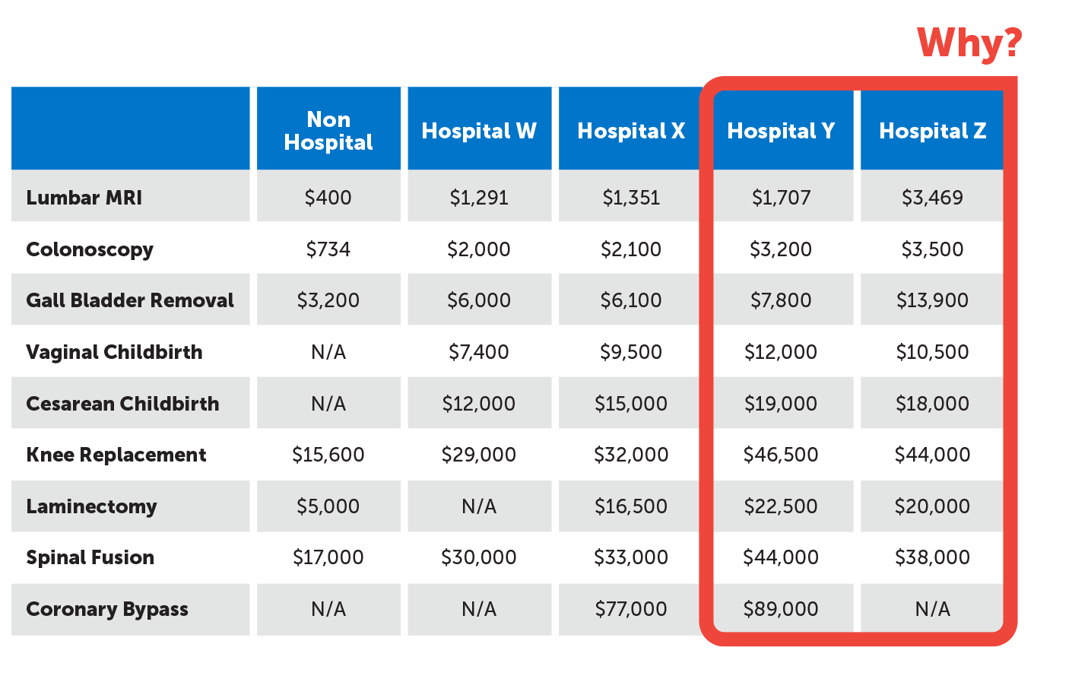
Comparing Hospital Pricing

Slide 6
High Out of Pocket Medical Expenses Cause Financial Stress
Did you know that over 69% of all personal bankruptcies in America happen because of medical debt?
78% of those who filed for bankruptcy due to medical debt, had insurance!

Slide 7
Out -of-Pocket Cost Comparison NovaHealth Plans vs Traditional Health Insurance
1 of 2
Traditional Health Insurance
$3,000 deductible EE $6,000 Fam / year + (co-insurance)
Claim | OOP/year | Accident Benefit | Hospital Benefit | Total cost
Cancer | $3,000+ co-ins. | none | none | $3,000 + co-ins.
Maternity | $3,000 + co-ins. | none | none | $3,000 + co-ins
Knee Replacement | $3,000 + co-ins. | none | none | $3,000 + co-ins
Broken Leg | $3,000 + co-ins. | none | none | $3,000 + co-ins
Torn Ligament | $3,000 + co-ins. | none | none | $3,000 + co-ins

Slide 8
Out -of-Pocket Cost Comparison NovaHealth Plans vs Traditional Health Insurance
2 of 2
NovaHealth 1000 Plans
$1,000 IUA 3X IUA maximums/year per member and family
Need | OOP/Need | Accident Benefit | Hospital Benefit | Cost | In Your Pocket
Cancer | $1,000 | n/a | $2,000 | $0 | $1,000
Maternity | $1,000 | n/a | $250 | $750 | $0
Knee Replacement | $1,000 | n/a | $2,000 | $0 | $1,000
Broken Leg | $1,000 | $3,500 est. | n/a | $0 | $2,500
Torn Ligament | $1,000 | $1,500 est. | n/a | $0 | $500
NEED: Expenses related to the same medical condition, whether expenses for a single incident or separate incidents, will be shared as one medical need request.
IUA: The initial unshareable amount, or IUA, is the amount that a member will pay before the Zion Health community shares in medical expenses

Slide 9

2021 Employee Benefits Benchmark Report CBIZ Employee Benefits
The Society for Human Resource Management (SHRM) reports that health insurance premiums have grown by 54% over the last 11 years. Moreover, employees have shouldered 71% of the burden. Things have come to a breaking point at which both employers and employees can no longer afford rising premiums. This suggests that employers will start looking for more innovative health care plans that allow them to better manage the rising cost of benefits.

Slide 10

Can Un-Affordable Health Insurance Be a Financial Safety Net?
Example #1 Actual client
Married couple plan premium costs over 5 years-$78,000 ($1,300/ month average premium)
Spouse diagnosed with cancer 5 years ago, pays the annual Out-of-Pocket Maximum of $6,000 every January for a total of $30,000 over 5 years.
Total costs over 5 years- $108,000 (does not include other spouse’s out-of-pocket costs)

Slide 11

Can Un-Affordable Health Insurance Be a Financial Safety Net?
Example #2 plan costs over the same period
Plan costs for a couple over 5 years = $48,212 ($803.54/month average premium)
Spouse pays $1,000 out-of-pocket maximum (IUA) for the duration of the illness.
Total costs over 5 years- $48,212 (does not include other spouses out-of-pocket costs)
Difference- $59,788 saved over 5 years 55%
Which example is the real
financial safety net?

Slide 12
SelectHealth Metal Plan Rates as of 11/01/22
Area/County/Zip: U003 / SALT LAKE / 84129
Metal | Deductible | Coinsurance | Copay | RX | Out of Pocket
Gold | $1,500/$3,500 | 80/20 | $25/$40 | $0 Ded (See MPS for Tier Benefits) | $7,350/$14,700
Gold | $1,000/$2,500 | 80/20 | $30/$50 | $600/$1,500 Ded (See MPS for Tier Benefits) | $7,350/$14,700
Silver | $1,750/$3,500 | 60/40 | $30/$50 AD | Combined Ded (See MPS for Tier Benefits) | $7,000/$14,000
Employee | EE+Spouse | EE+Children | Family
$487.00 | $974.00 | $1022.70 | $1509.70
Employee | EE+Spouse | EE+Children | Family
$448.00 | $896.10 | $940.90 | $1388.90
Employee | EE+Spouse | EE+Children | Family
$387.50 | $775.00 | $813.70 | $1201.20

Slide 13
How The NovaHealth Plans Help Solve These Problems Low Affordable Rates
Save 30-50% over traditional health insurance rates.
NovaHealth 1000 MC
Monthly Rates
Status | Age | Rate | IUA (Deductible) | Out of Pocket Max
Individual | 28 | $389.25 | $1,000 | $3,000
Individual | 24 | $389.25 | $1,000 | $3,000
Individual | 35 | $414.25 | $1,000 | $3,000
Individual | 55 | $499.66 | $1,000 | $3,000
Couple | 47 | $684.68 | $1,000 | $3,000
Ind / children | 29 | $689.29 | $1,000 | $3,000
Ind / children | 33 | $714.29 | $1,000 | $3,000
Family | 35 | $923.48 | $1,000 | $3,000
Family | 38 | $923.48 | $1,000 | $3,000
Family | 53 | $1142.4 | $1,000 | $3,000

Slide 14
How The NovaHealth Plans Help Solve These Problems (continued..)
No rate increases historically
Out-of-pocket costs can be as low as $0
Pre-existing conditions can be covered
No networks needed to access Zion Health benefits
Medical bills negotiated to lowest cost (this keeps plan rates low)
Accident and hospital benefits pay cash to you to help off-set out-of-pocket costs
Urgent care/ virtual primary care $10 co-pay (Utah)
Telemedicine 24/7/365 no co-pay
Dental/Vision Discount Plans

Slide 15

Ready to get off that traditional Health Insurance Merry-go-round?
You can change your health plan any time!
Start saving money now!
Lower your monthly premiums by 30-50%
Rate Stability
Lower out-of-pockets costs to near $0
Recruit and retain employees with benefits that make financial sense!
Recruit and retain employees with benefits that make financial sense!

Slide 16

Action Steps
Let us analyze your current health plan
Compare rates and benefits
Provide the information you need to make an informed decision

Slide 17
NovaHealth Plans Synergistically Combine Essential Elements Into One Health Plan Producing Better Benefits and Better Commissions
Produce richer over-all benefits than traditional health insurance.
Monthly costs are 30% to 50% less than traditional health insurance.
Out-of-pocket costs are greatly reduced, sometimes as low as $0.

Slide 18
Our TPA Billing/Payment System Is Good for Brokers, Individuals, and Employers
Employer sees one bank draft amount for the NovaHealth Plans, instead of several. It is simple for employers.
Brokers commissions are increased by utilizing several commissionable elements inside the NovaHealth plans.
Broker commissions are comparable or better than traditional fully insured plans.
You can provide your clients with the best solution without sacrificing your commissions.

Slide 19
How our TPA system Works
Worksite Benefits prepares a monthly report for the TPA for each individual or group.
TPA drafts each individual or group using (EFT) electronic funds transfers.
TPA receives the drafted funds then makes EFT disbursements to vendors, carriers, brokers and other entities.
Commissions are paid by Miller and Wade to their brokers.

Slide 20

Traditional Health Insurance
Traditional insurance can be expensive and difficult to understand. It can leave you isolated, confused, and often cost you unnecessary out-of-picket expenses. On top of that, providers don’t often communicated, creating multiple game plans with multiple points of contact. This leaves the patient frustrated and creates a difficult path to managing their care.

Slide 21
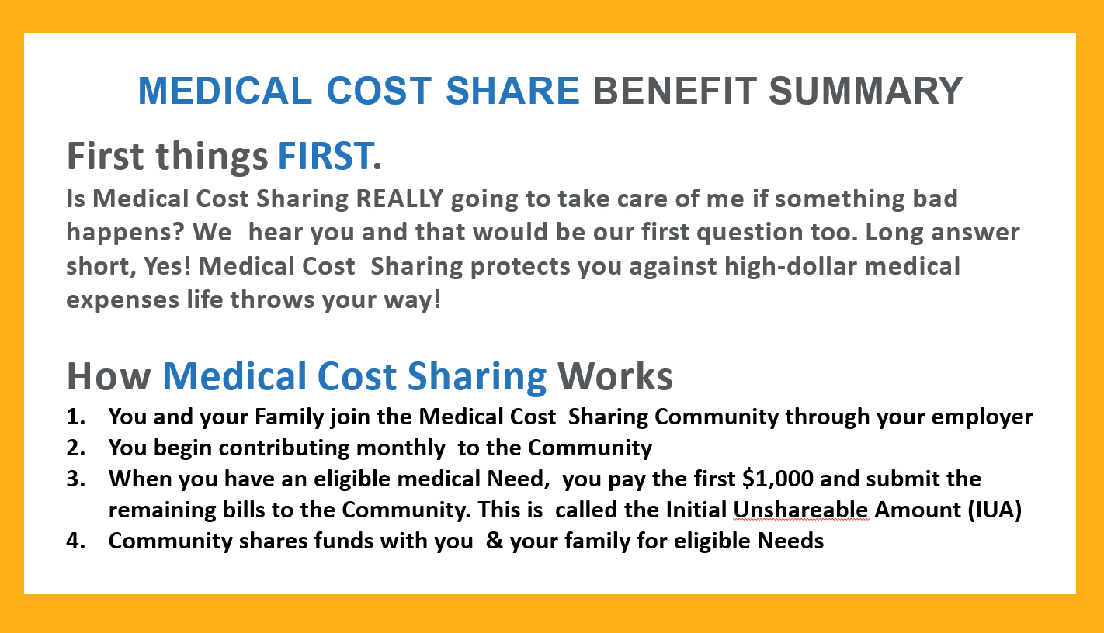

Slide 22
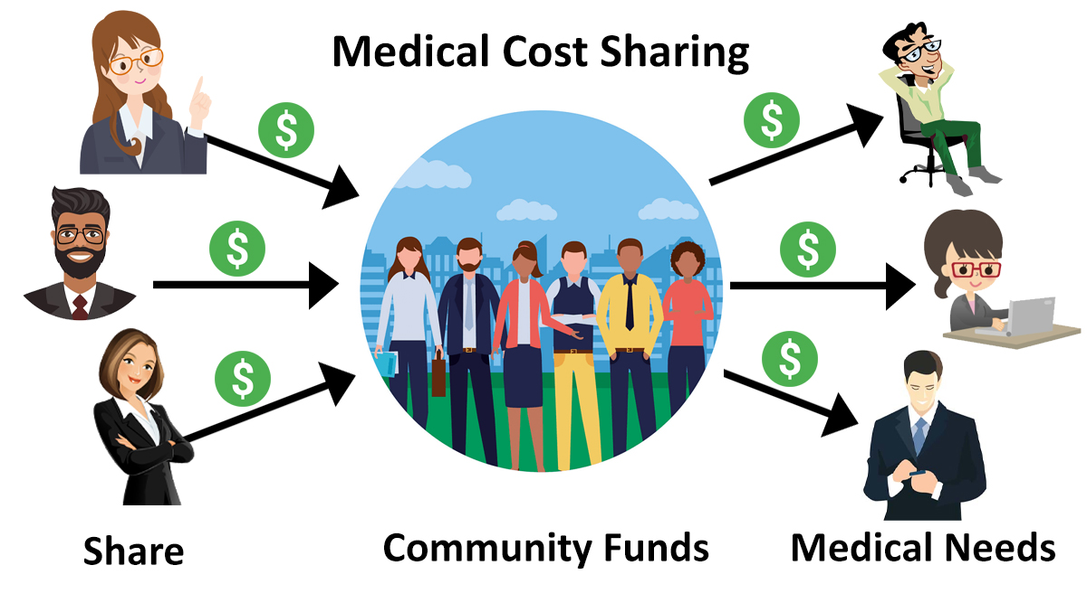
Instead of paying monthly premiums to an insurance company, members share a given amount on a monthly basis and draw from community funds as medical Needs arise

