Slide 1

Recruiting and Retaining Great Employees with Truly Affordable Benefits
Presented by Ken Hostetter, Broker

Slide 2
Who We Are
Our seasoned team of experts has combined experience of 65+ years in the employee benefits arena beginning in 1986. This helped establish our solid foundation of knowledge and experience that continues today.
Today, as benefit costs have reached an all-time high, we excel in providing innovative solutions to our clients. Our solutions can help your company find the answers to stay competitive and provide truly affordable benefits to your valuable employees.

Slide 3
IN 2020 the IRS Approved ICHRA ( Individual Coverage Health Reimbursement Arrangements) that provide:
Employer benefit plan cost control
Expanded employee health plan choices
Better tools to recruit and retain employees

Slide 4
Why Offer Benefits to Your Employees?
A recent SHRM (the Society for Human Resource Management) survey shows:
Benefits help employers compete for talent
Quality and affordable benefits increase employee retention/reduce cost of turnover
Promote better performance from happier employees

Slide 5

2021 Employee Benefits
Benchmark Report
CBIZ Employee Benefits
The Society for Human Resource Management (SHRM) reports that health insurance premiums have grown by 54% over the last 11 years. Moreover, employees have shouldered 71% of the burden. Things have come to a breaking point at which both employers and employees can no longer afford rising premiums.
This suggests that employers will start looking for more innovative health care plans that allow them to better manage the rising cost of benefits.

Slide 6
We have Solutions to the high cost of healthcare!

Slide 7
ICHRA INTRODUCTION
ICHRA Plans are a new, more efficient way for businesses to offer health insurance to their employees.
ICHRA plans allows businesses to offer health benefits pre-tax without the high cost and headache of traditional group insurance plans.

Slide 8
ICHRA Plans Are More Cost-Effective Than Group Health Insurance
Employers choose their “contribution” or reimbursement amount, not the insurance company
Reimbursements may be based on age, job class and number of dependents.
No minimum participation requirements.

Slide 9
ICHRA Basics
Employer Reimburses Employees for Individual Health insurance of their choosing
Tax free reimbursements to employees
Business expense for the employer

Slide 10
ICHRA Basics
Employee Requirements for ICHRA
To receive tax-free reimbursements:
An employee must have or sign up for Individual (or family) health insurance coverage which provides coverage of essential benefits, preventive and emergency services .
Must prove coverage.

Slide 11
ICHRA A WIN/WIN
Employees like ICHRA plans because they get to choose the health coverage that works best for them, instead of getting stuck with a one size fits all employer group plan..
ICHRA allows employers to contribute to a health insurance plan that fits the employer’s budget and employees' needs.

Slide 12
ICHRA Pre-Tax Options
HSAs and Flex Spending Accounts Allowed
HSA contributions are allowed if the employee selects a Qualified High Deductible Health Plan
Flex Spending Accounts are allowed

Slide 13

ICHRA Plans Open the Way to Other Affordable Plan Choices for Employees
Employees May Also Choose a Non-Traditional Health Plan
NovaHealth Plans
3 plan choices
Rates 30-50% lower than Traditional Health Insurance plans
Designed to greatly reduce plan out-of- pocket costs

Slide 14

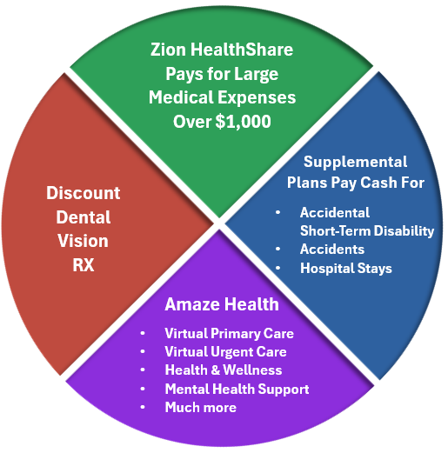
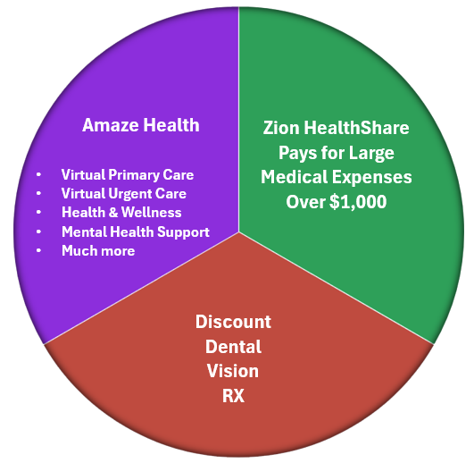
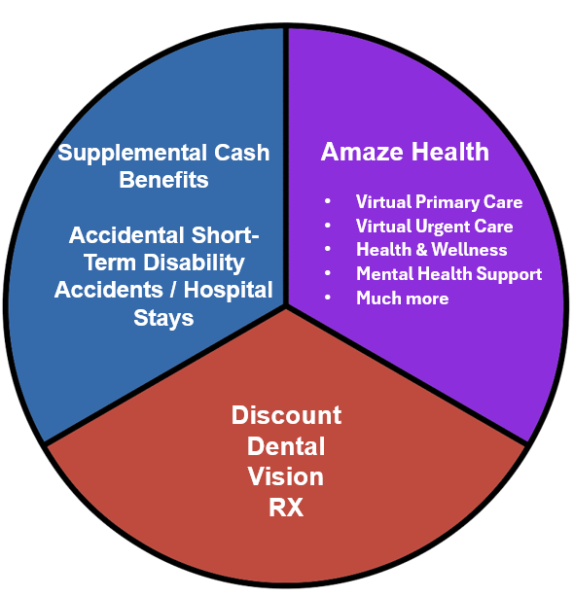
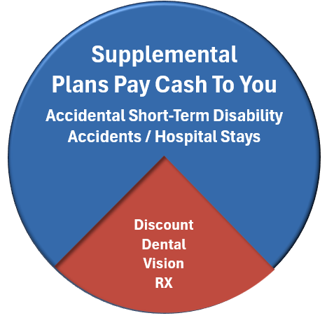
Flex Choice Options
EMPLOYER MAKES A CONTRIBUTION TOWARD EITHER ICHRA PLANS OR NON-TRADITIONAL HEALTH PLANS
Choose a Non-Traditional NovaHealth Plan
Choose an Individual Health Plan
Using ICHRA (Individual Coverage Health
Reimbursement Arrangement)
Tax-Free reimbursement for health insurance plan premiums
Employer chooses contribution amount
Employee chooses a health insurance plan that fits their needs
1000
2000
FEATURES:
3000

Slide 15

A fundamental
paradigm shift, in how health plans work.

Slide 16
2024 Survey Results: High Out of Pocket Medical Expenses Cause Financial Stress
Did you know that over 69% of all personal bankruptcies in America happen because of medical debt?
78% of those who filed for bankruptcy due to medical debt, had “good” insurance!

Slide 17
High Premiums Plus High Deductibles/Co-Insurance (O.O.P. Max) Equal Financial Disasters for Employees
Typical Deductibles and Out-of-Pocket Maximums examples:
Deductibles: $3,000/$5,000 individual/family, O.O.P. max: $8,000/$20,000 individual/family
What if a person has to pay their O.O.P. max because of a serious accident or illness? Some may have to pay this every year!
Where does the money come from? savings, HSA, 401K, home refinance, credit cards, installment payments to the hospital/ doctor?? ----- Or if you run out of money---BK!

Slide 18

NovaHealth 1000
Most Comprehensive Plan
Zion HealthShare
Pays for Large
Medical Expenses
Over $1,000
30 to 50% Lower Cost Than Traditional Health Plans
Supplemental
Plans Pay Cash For
Out-of-Pocket Costs As Low As $0
Discount
Dental
Vision
RX
Accidental
Short-Term Disability
Accidents
Hospital Stays
Amaze Health
Virtual Primary Care
Virtual Urgent Care
Health & Wellness
Mental Health Support
Much more

Slide 19
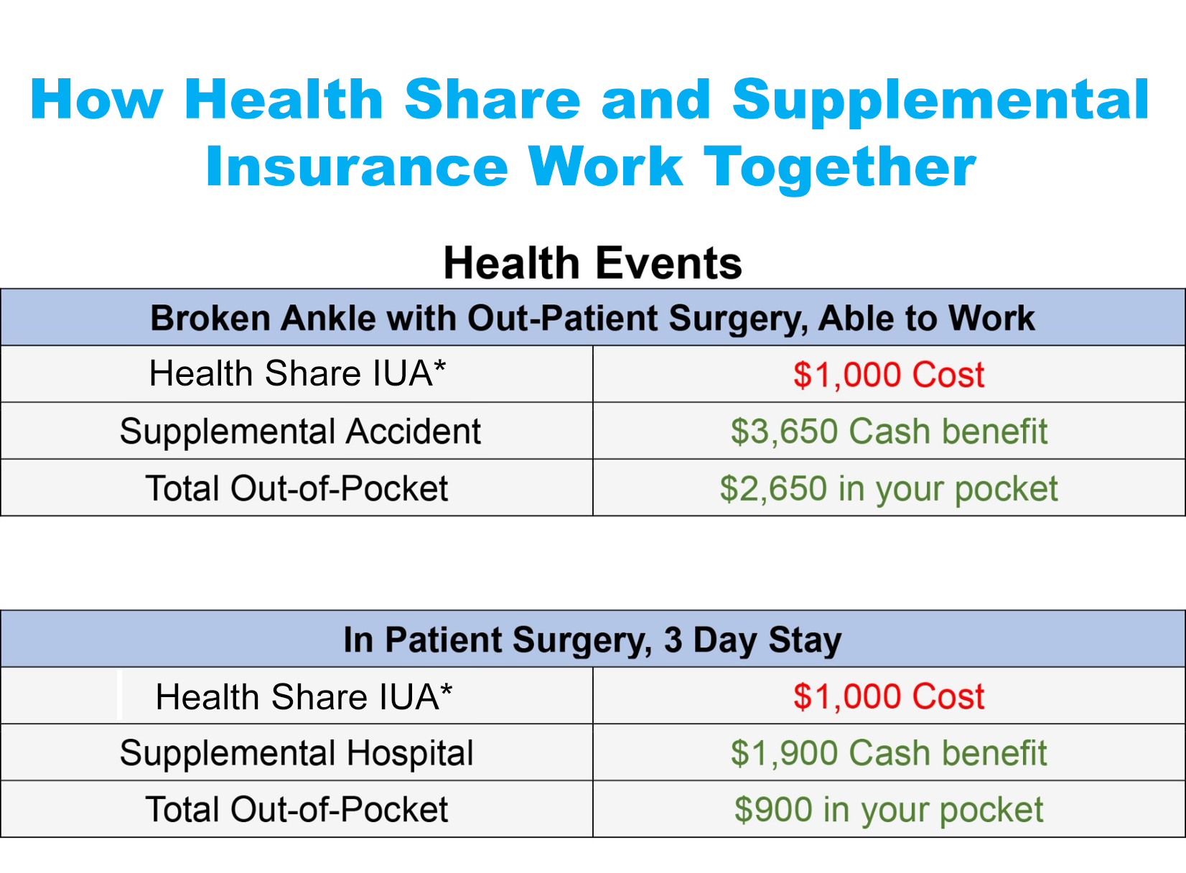

Slide 20
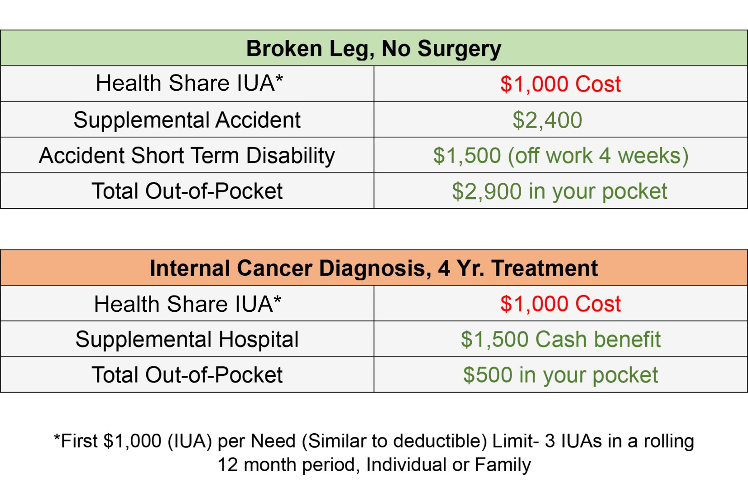

Slide 21
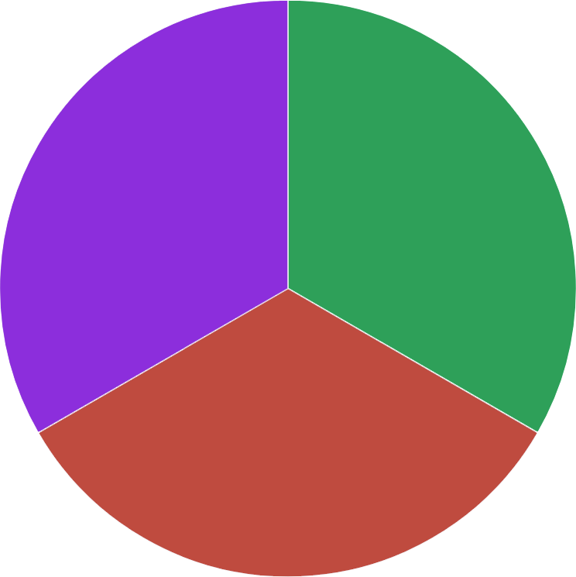
NovaHealth 2000
Budget Comprehensive Plan
30 to 50% Lower Cost Than Traditional Health Plans
Amaze Health
Zion HealthShare
Pays for Large
Medical Expenses
Over $1,000
Virtual Primary Care
Virtual Urgent Care
Health & Wellness
Mental Health Support
Much more
Discount
Dental
Vision
RX
Can add:
accident/short-term disability, hospital

Slide 22
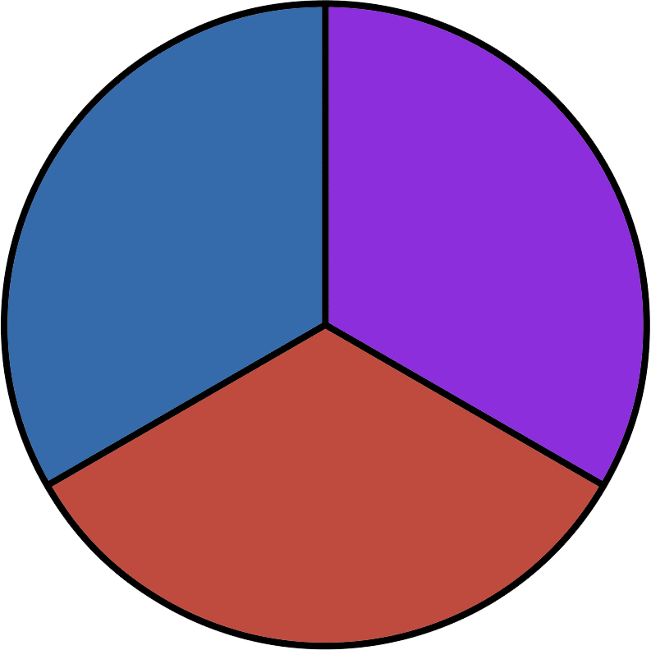
NovaHealth 3000
Reduce Out of Pocket Costs / Works With Any Health Plan
Supplemental Cash Benefits
Accidental Short-Term Disability
Accidents / Hospital Stays
Amaze Health
Virtual Primary Care
Virtual Urgent Care
Health & Wellness
Mental Health Support
Much more
Discount
Dental
Vision
RX

Slide 23
Group Health Plans V.S. Flex Choice
Employer Requirements
 | Group Health Plan | ICHRA Plans | NON-TRADITIONAL HEALTH Plans
Minimum Contribution | Single Employee rate $400-$500 per month | Employer sets amount | Employer sets amount
Minimum Participation | 75% of eligible employees | none | 3 participants

Slide 24
Flex Choice Wrap-up
Employers offer non-traditional NovaHealth plans and ICHRA
Employers save money over group health plans
Employees get access to a wider selection of truly affordable health plans
Employer determines the reimbursement/contribution amount for ICHRA and non-traditional NovaHealth plans.
Low participation requirements
You can start Flex Choice any month of the year. No need to wait for open enrollment.
Employers can now recruit and retain great employees with benefits they can afford and use without worry of financial stress or bankruptcy

Slide 25

Take Action Now
Why wait? Get information now!
Visit Us at Booth 39
Get information: Contact Info:
Ken Hostetter
(801) 910-9430 Ken@worksitebenefitsnow.com

